Slide 1
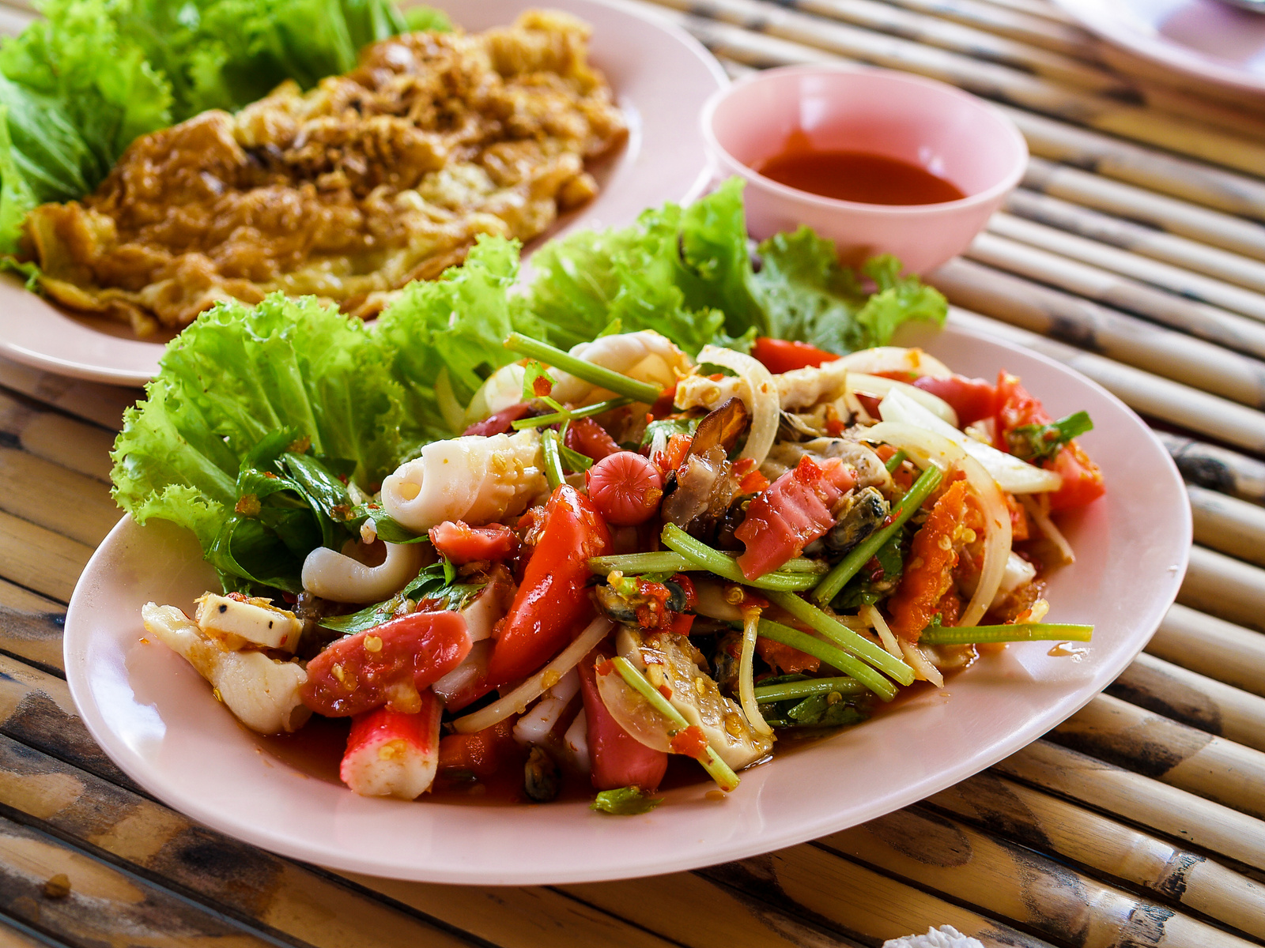

Customer loyalty and rewards program

Slide 2




Our Team
Divi joshi
Hetal Gala
Kunal Chopra

Slide 3
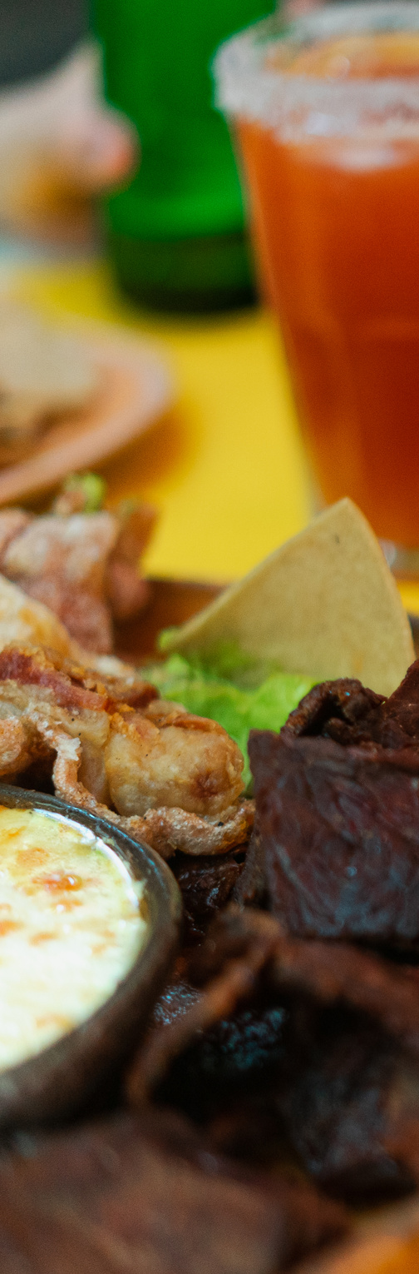

What's Our IP?
increase customer engagement
retain existing customers
create a competitive advantage
Customer loyalty and rewards program that incentivizes customers to order from our business regularly and to refer new customers to the app.
increase customer lifetime value
customers earn rewards and offers

Slide 4



How our IP combat against Porter’s five forces:
THREAT OF NEW ENTRANTS
BARGAINING POWER OF BUYERS
Reward customers for repeat business
Personalize offers based on customer preferences
Partner with local businesses
Offer early access to new restaurant partners
Offer rewards for referrals
Offer personalized customer service
Create a VIP program
Offer rewards for customer feedback

Slide 5


Strategy
retain existing customers
enhances customer lifetime value
creates competitive advantage
increased customer engagement
stronger relationship with customers
effective marketing
better product development
increased customer satisfaction
high growth and profits

Slide 6
Quality
customer behavior
customer preferences
customer engagement
most effective rewards and incentives
most loyal customers
most valuable customer segments

Slide 7
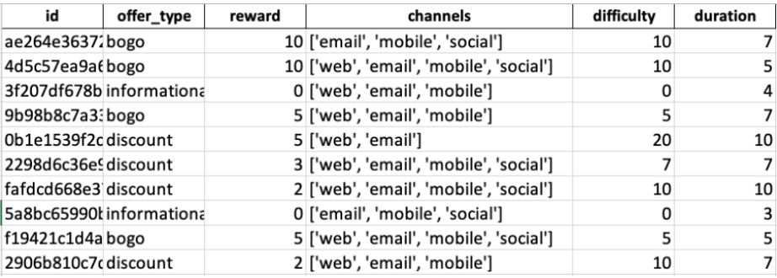
Portfolio
This information will be used to analyze the performance of different types of offers and to identify which offers are most effective in incentivizing customers to place orders.
Notes:
-offer ID
-the type of offer (BOGO, discount, or informational)
-the minimum amount that must be spent to complete an offer
-the reward for doing so,
-the offer's duration in days, and
-the channels through which it was sent.

Slide 8
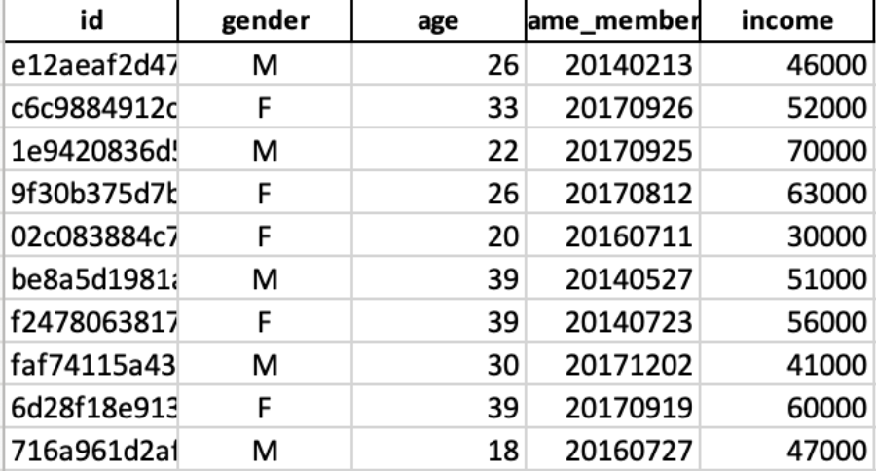
This information will be used to segment the customer base and to identify which customer segments are the most valuable to the business. It will also be used to analyze the preferences and behaviors of different customer segments and to tailor loyalty programs and marketing strategies accordingly.
Profile
Notes:
-customer's id
-gender
-age
-date the customer joined the rewards program
-income

Slide 9
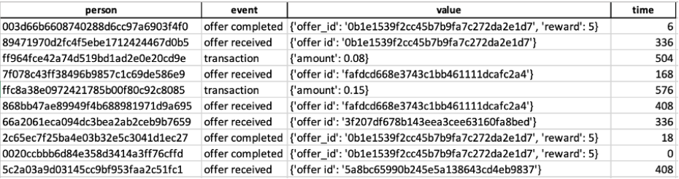
This information will be used to analyze the effectiveness of different offers and to identify which offers are most likely to result in customer engagement and repeat orders. It will also be used to understand the customer journey and to identify areas where the loyalty program and customer experience can be improved.
Transcript
Notes:
-customer's ID
-event i.e. whether the offer was received, viewed, completed, or a transaction was carried out that did not qualify for the offer
-or spent on each transaction
-time (in secs)

Slide 10
Assessing the quality of the data sets
Completeness
Consistency
Accuracy
Relevance
Validity

Slide 11

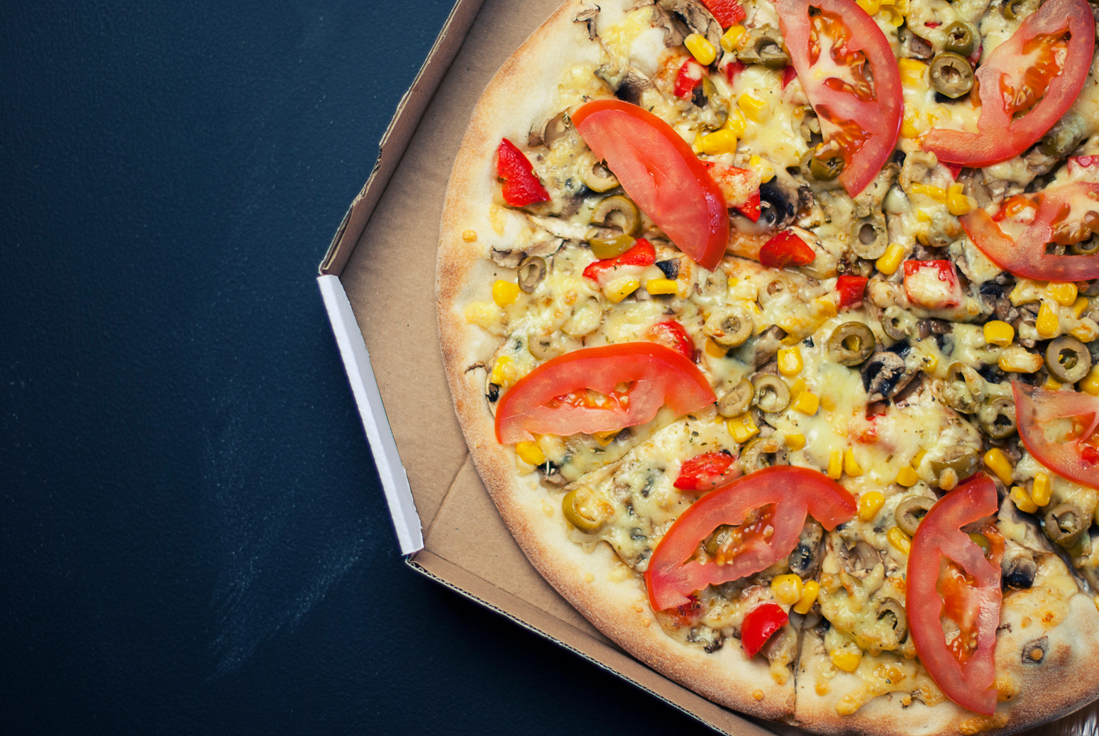

Challenges
Defining the right rewards and incentives
1
2
Balancing costs and benefits
Creating a seamless user experience
3
Measuring program effectiveness
4
Adapting to changing customer preferences
5

Slide 12



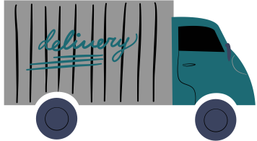
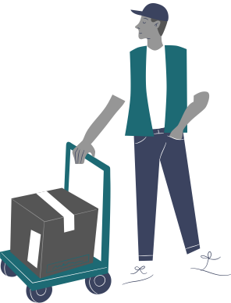


Thank you for listening!
Don't hesitate to ask any questions!

